Slide 1
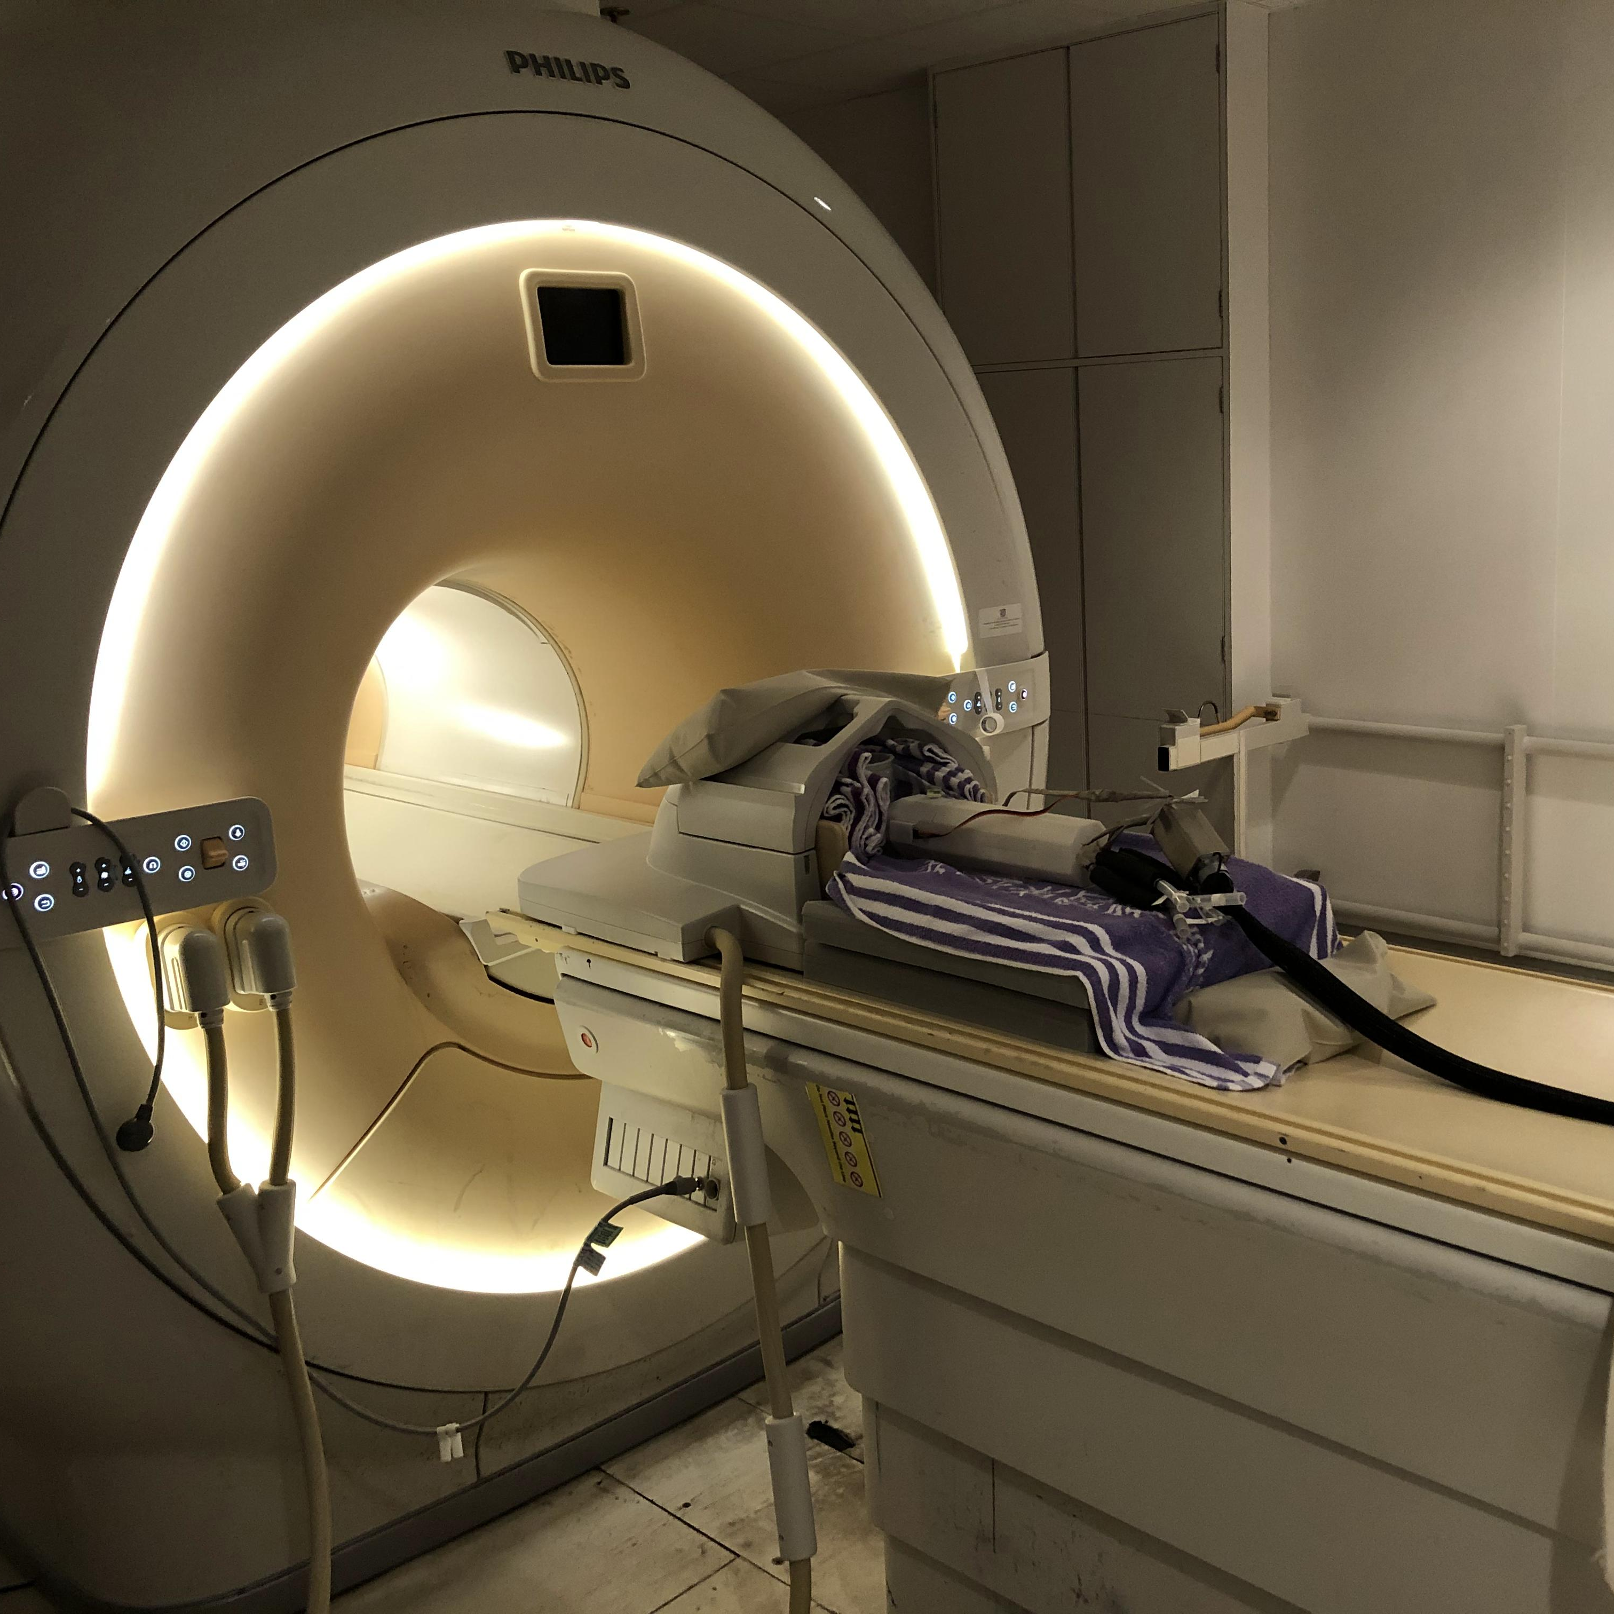
V0.3.0
64-bit (win64)
August 2023
For internal test only
Neurosurgical Robot
Control Console
Configure and control the MRI compatible robotic system
Surgical Robotics and Instrumentation Lab
CUHK

Slide 2
V0.2.1
64-bit (win64)
September 20, 2021
For internal test only
Neurosurgical Robot
Control Console
Configure, control and monitor for the MRI compatible neurosurgical robotic system.
Surgical Robotics and Devices Laboratory
CUHK

